Slide 1
Grizzly Paths
By: Sam Downs

Slide 2
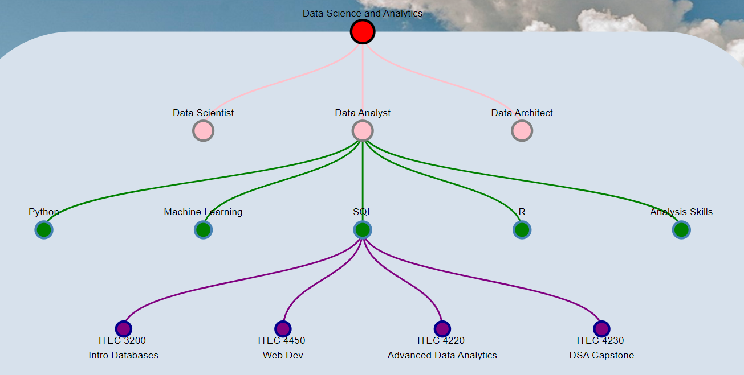
Introduction/goal
The goal of Grizzly Paths is to provide a web app to students which suggests classes to take according to their concentration

Slide 3
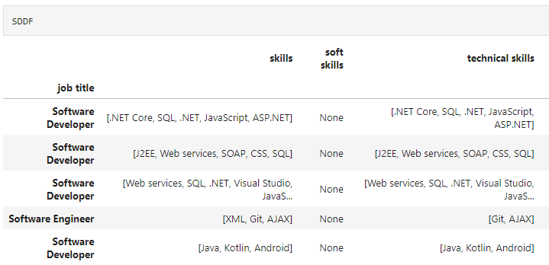
What has been done previously
Job information has been scraped from job posting websites (indeed and simply hired) and organized (cleaned) with:
Generalized job titles
Separated soft and technical skills
The most common job titles for each concentration is put on the website

Slide 4
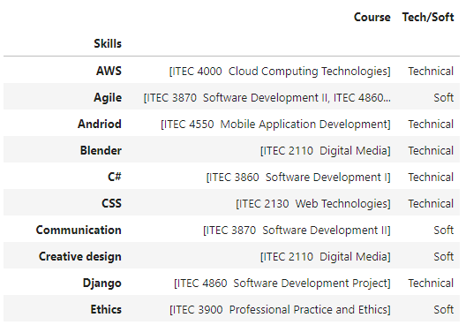
What has been done this semester
Find which courses teach the listed skills and compile the skills into a list
Add each course to the corresponding skill on the website

Slide 5
Disclaimers/What needs to be done
The job data is a bit out of date (by about a year at this point)
The data for the skills taught by courses might be incomplete
Some technical skills are not taught at GGC and are either left with no course node (ex SEO) or the node has been removed (ex. DevOps)
The website needs more editing (add disclaimer and edit the spacing of the wording, etc.)

